Slide 1

Expository Writing

Slide 2

The How and Why of Writing

Slide 3
Objectives
By the end of this lesson, students will know:
organizational strategies to convey ideas and concepts
the difference between informational and explanatory texts
both informational and explanatory texts are classified as expository texts

Slide 4
Objectives
By the end of this lesson, students will know:
analyze relevant content to support a topic or idea
demonstrate the proper structure of an informational text
demonstrate the proper structure of an explanatory text
demonstrate support of a topic through the selection, organization, and analysis of content

Slide 5
Narrative vs. Expository
Tells a story
Has action
Author’s purpose: to entertain
Has conflict & dialogue
Has characters & theme
Has a definite beginning, middle, and end
Key words- Tell about a time, tell what happened next, and write a story
Ex. Folktale, fable, myths, suspense-filled stories
Provides information
Explanations/ directions
Author’s purpose: to inform or explain
Has a central idea (thesis)
Organized by: compare/contrast, cause & effect, chronological order, problem & solution, or question/answer
Key words- Explain, tell how
Ex. Internet, biography, dictionary, encyclopedia

Slide 6
Informative vs. Explanatory
May include a person’s views on something such as an experience or an activity or explains how to do something without providing argument or criticism
Designed to convey facts and data through chronological order, compare/contrast, definition, or cause and effect
Both types are Expository

Slide 7
??????
How can I write an effective informative/explanatory text that clearly conveys ideas, concepts, and information?

Slide 8
What is Expository Writing?
Expository writing is defined as presenting reasons, explanations, or steps in a process
Informational writing
An expository essay should follow a logical sequence and have three different main points
Logic and coherence is the main focus of an expository essay

Slide 9
How is it different from other types of writing?
Expository writing does not tell a story
Expository writing does not persuade a reader but only gives facts and reasons
Expository writing can also give the steps of a process

Slide 10
Introduction (Expository Writing)
Introduction of an expository should include the main idea and what the essay is about
The three main reasons supporting this main idea should also be included in the introduction

Slide 11
5 Elements of expository writing
1. Organization
2. Topic Sentence, Thesis Statement, and Subtopics
3. Transitions
4. Evidence and Examples
5. Conclusion

Slide 12
Element 1: Organization
When you organize an essay it needs to follow a logical sequence.
Novel: beginning of the book, middle of the book, end of the book.
2/3/1: 2nd best idea, 3rd best idea, best idea.
Directions:
1st step, 2nd step, 3rd step.

Slide 13
Organization Example
Topic: Bicycle Safety Rules
Idea 1: Wear a Helmet
-every time you ride.
-fasten correctly.
Idea 2: Stop and Look
-at every corner
-near alleys/driveways
Idea 3: Bike in Safe Areas
-with a friend/adult
-during the day.

Slide 14
Element 2: introductory Sentences
Thesis: a statement discussing the topic of your paper.
Subtopics: the main ideas that support your thesis.
Topic Sentences: a statement that discusses the topic of each paragraph.

Slide 15
Thesis statement
Grab the reader’s attention by:
Asking a question ????
Using some key words from the writing prompt.
Include a thesis statement

Slide 16
Grab the reader’s attention by:
Onomatopoeia (Bang!)
Onomatopoeia is a figure of speech in which words evoke the actual sound of the thing they refer to or describe. The “boom” of a firework exploding, the “tick tock” of a clock, and the “ding dong” of a doorbell are all examples of onomatopoeia.

Slide 17
INTRODUCTION
INDENT!!!! (To indent is to begin text with a blank space between it and the margin. When you're writing an essay, you can indent the first sentence of each paragraph).
Needs to be 3-5 sentences
NO “I” in the introduction
NEVER say “Let me tell you…” or “I am going to tell you about...” → ABSOLUTELY NOTHING like that…EVER
The wording needs to concise and clear→
NO EXTRA information…

Slide 18
HOOK
A sentence that grabs the reader’s attention. It should relate to the broad idea of the topic in a high-interest way.
GOOD ones are:
-an amazing fact -a detailed description -a quote, proverb -a bold opinion -a statistic

Slide 19

HOOK (PRACTICE)
Your turn!! Practice brainstorming possible HOOK sentence ideas over the prompt. Ask yourself…what will catch my readers attention?
Now, pick 1 of your best brainstorm ideas, and create a statement that will catch your readers interest…

Slide 20
HOOK (Turn and Talk)
10 minutes
Share your HOOK sentences with your shoulder partner.
Ask yourself
Does my HOOK catch the attention of my reader? If not, what can I do to improve this?
Help each other create a stronger hook sentence.
Class “share out louds”

Slide 21

BROAD STATEMENT / Visionary Approach
Idea or statement that covers a large range of people
Meaning, the statement can be applied to MANY people
KEY WORDS: Always All Many Most
EXAMPLE: People all
over the world love animals.

Slide 22
BROAD STATMENT (PRACTICE)
Your turn!! Practice brainstorming possible BROAD STATEMENT ideas over the provided prompt. Ask yourself…Can my BROAD STATEMENT be applied to MANY people?

Slide 23

GENERAL STATMENT
Idea that applies to fewer people or situations

Slide 24
GENERAL STATEMENT (Turn & Talk )
5 minutes
Ask yourself”
Is my GENERAL STATEMENT more specific then my broad statement??
Share your GENERAL STATMENT with your shoulder partner.
Help each other create a GENERAL STATEMENT that is focused around the prompt and is a little more specific than your broad statement.
Class “share out louds”

Slide 25


Let’s think about it in relation to comparing and contrasting a book and a movie…

Slide 26
Point by Point Method
Introduction
Point #1 (Characters in book and movie)
Point #2 (Setting in book and movie)
Conclusion

Slide 27
Transitional Words and Phrases to Compare/Contrast
Compare
Contrast
also
and
another
in the same way
likewise
moreover
similarly
too
although
but
even though
however
on the other hand
unlike
yet

Slide 28
Thesis
Although my family and I have taken many vacations, none was more exciting than a trip to the Muree.

Slide 29
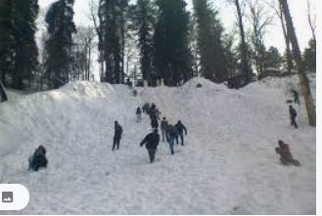

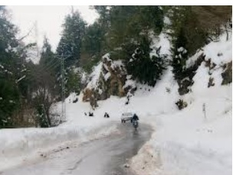
Subtopics
The Muree was a great place to visit because of the spectacular views, the challenging hike to the top, and the time we had to bond as a family.

Slide 30
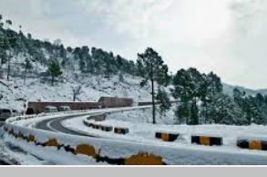
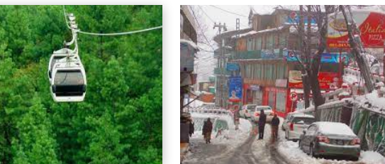
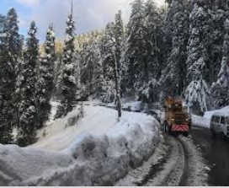
Topic Sentence
Muree offered spectacular views like I had never seen before.

Slide 31
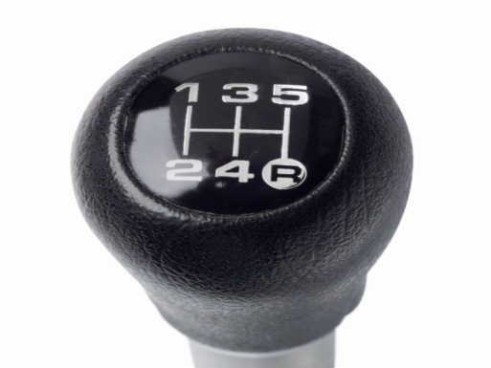
Element 3: Transitions
Like shifting from one gear to the next in a car, a transition shifts from one paragraph to the next.
It is the glue of an essay.

Slide 32
Transition Example
Paragraph One:
This task can become easier and more rewarding when students use two comprehension categories, such as surveying textbooks or tell backs.
Transition: One powerful strategy is a chapter study guide to help you review textbooks.

Slide 33
Element 4: Evidence and Examples
Your evidence is the meat of the essay. You need to prove what you know.
Remember the E’s:
-Examples
-Explanations
-Evidence
-Elaboration

Slide 34
Evidence Example
Topic Sentence:
If you look carefully, you may discover unsafe conditions around the house.
Evidence: Get rid of old rags, papers, trash, and chemicals. Are your hallways well lit? Make sure all bolts on doors are firmly attached.

Slide 35

Element 5: Conclusion
Conclusions restate your thesis and subtopics, and remind your reader what you wrote about.
They wrap up your writing.

Slide 36
Conclusion Example
Reading, remembering, and using textbook information is a challenge.
Using strategies like textbook surveys, tell backs, and journals can help your comprehension.
If you work hard, the results are worth it.

Slide 37
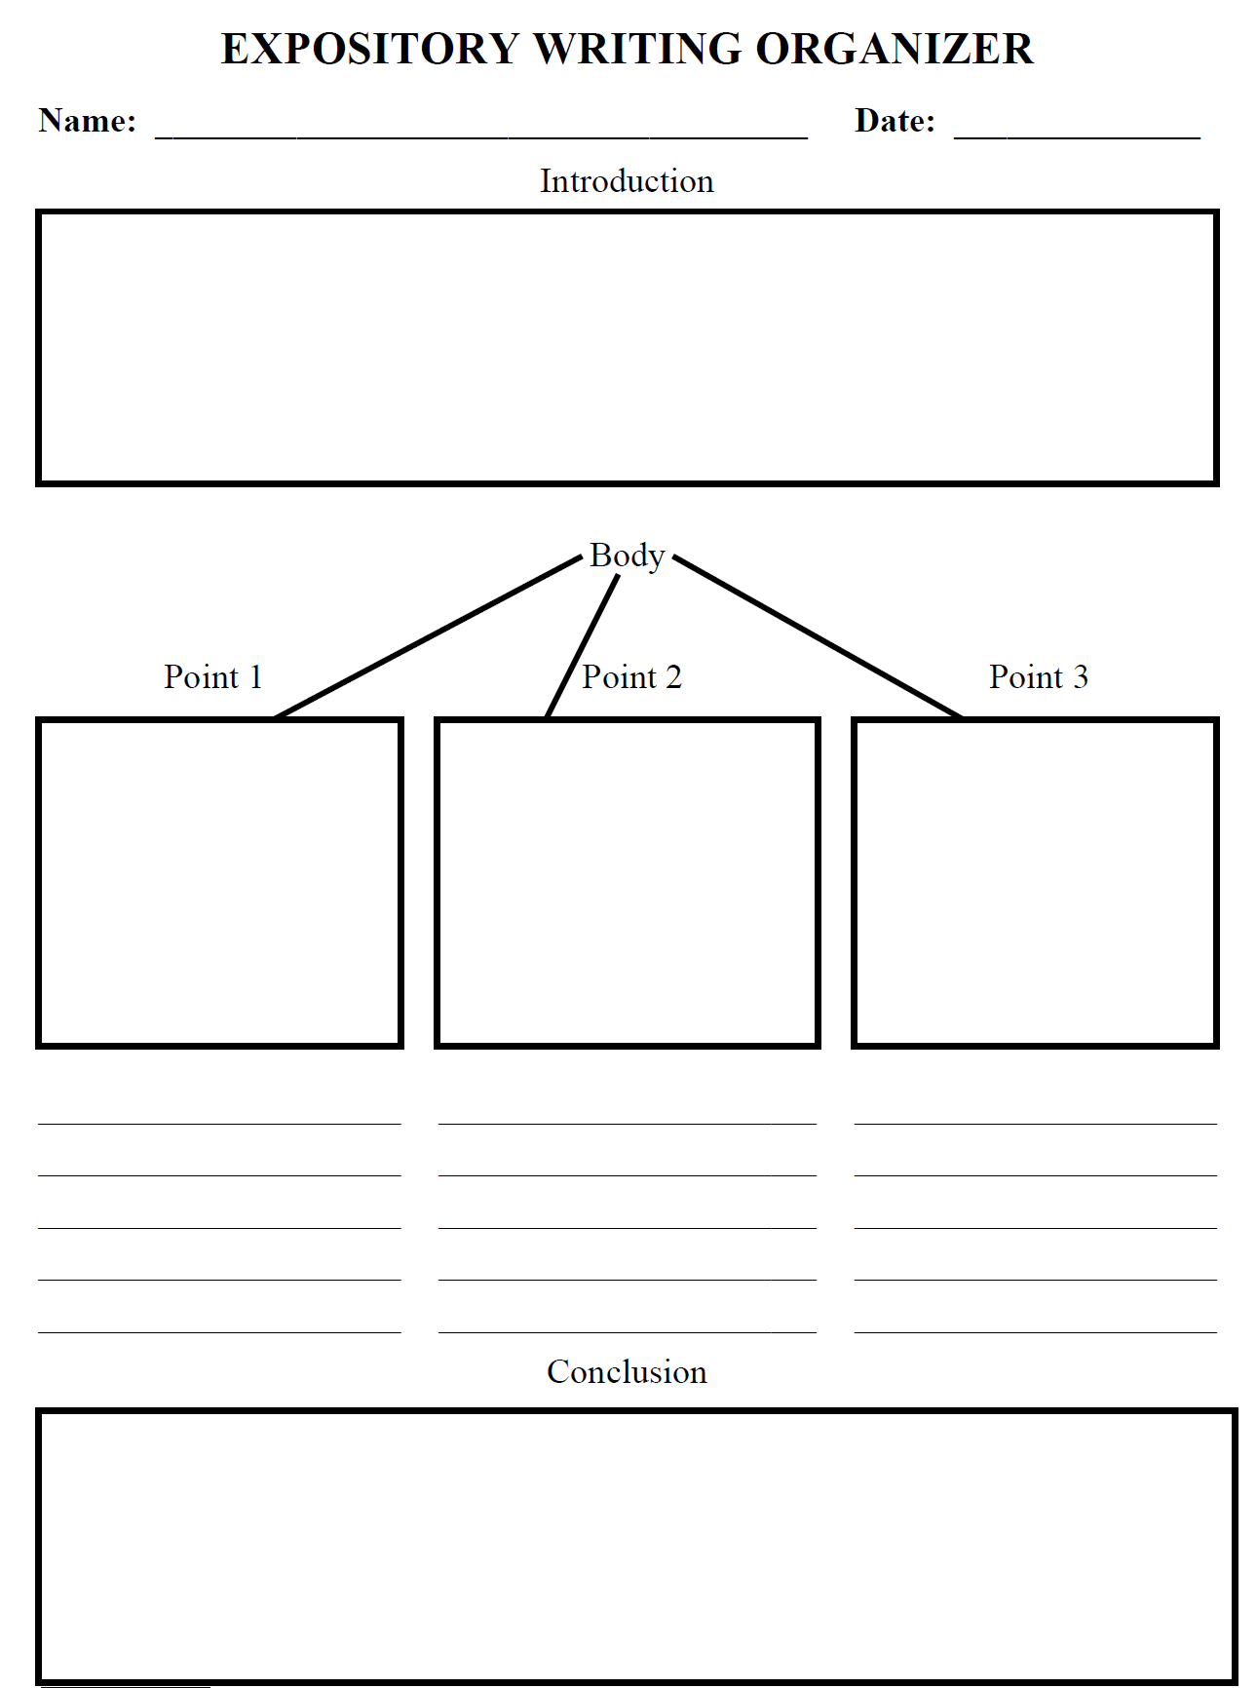

Slide 38
Editing your essay
Check that you have all the elements of an expository essay:
Reasons
Details
Transition words
Conclusion that re-states your topic
Correct grammar/usage
Coherence, logic and clear writing

Slide 39
Topic/Unit 1
Subheading (if any)
Reference: Management, Eleventh edition, by Stephen P. Robbins and Mary Coulter.

Slide 40
THANK YOU

